Slide 1
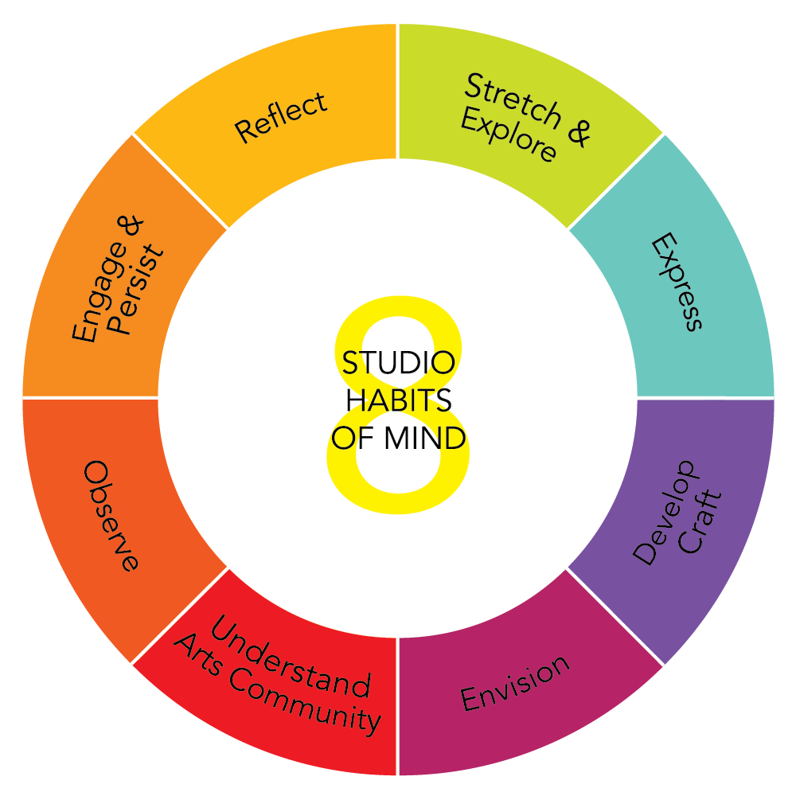
Demo: Kawaii Art
Drawing CENTER
Stick to it!
Don’t give up!
Practicing an Art Form
& Using tools and materials

Slide 2
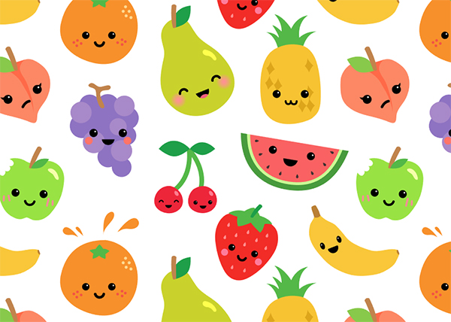
Kawaii
Art

Slide 3
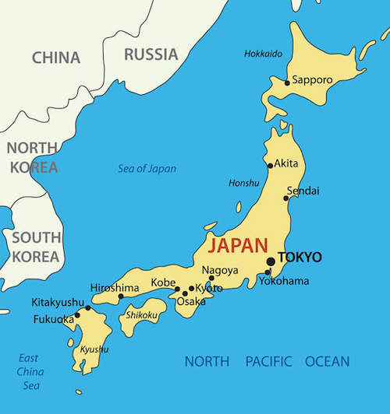
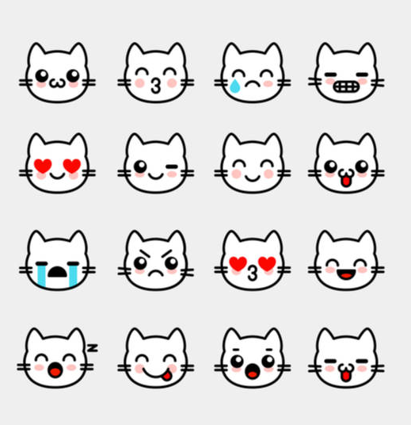
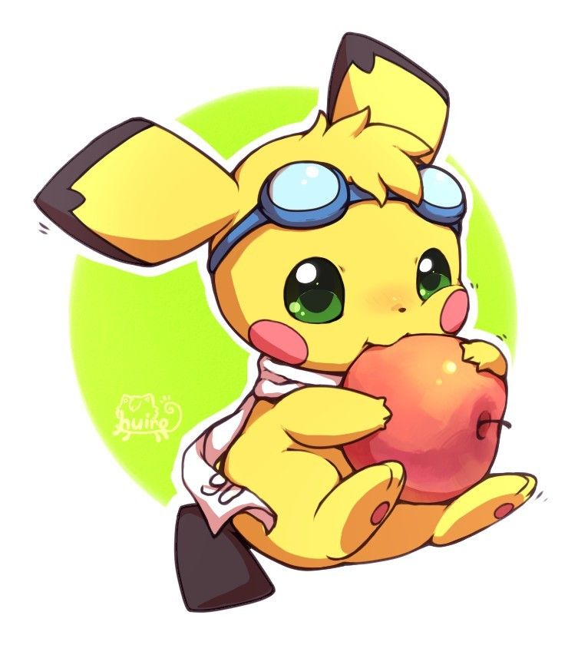
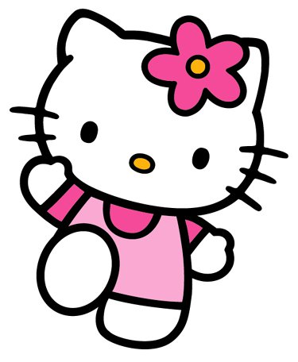
What is Kawaii?
It comes from the Japanese word meaning “cute”.
A lot of things were inspired by Kawaii culture: Pokemon,
Emoji’s, Hello Kitty

Slide 4
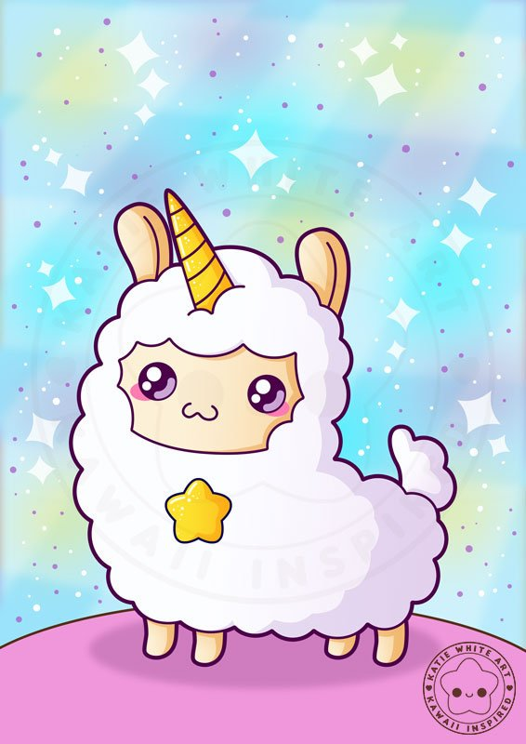
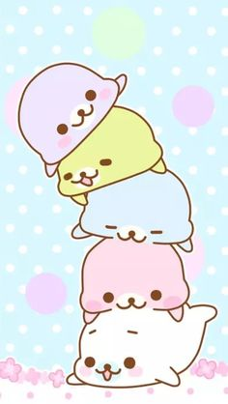
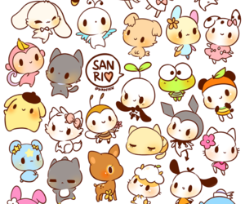
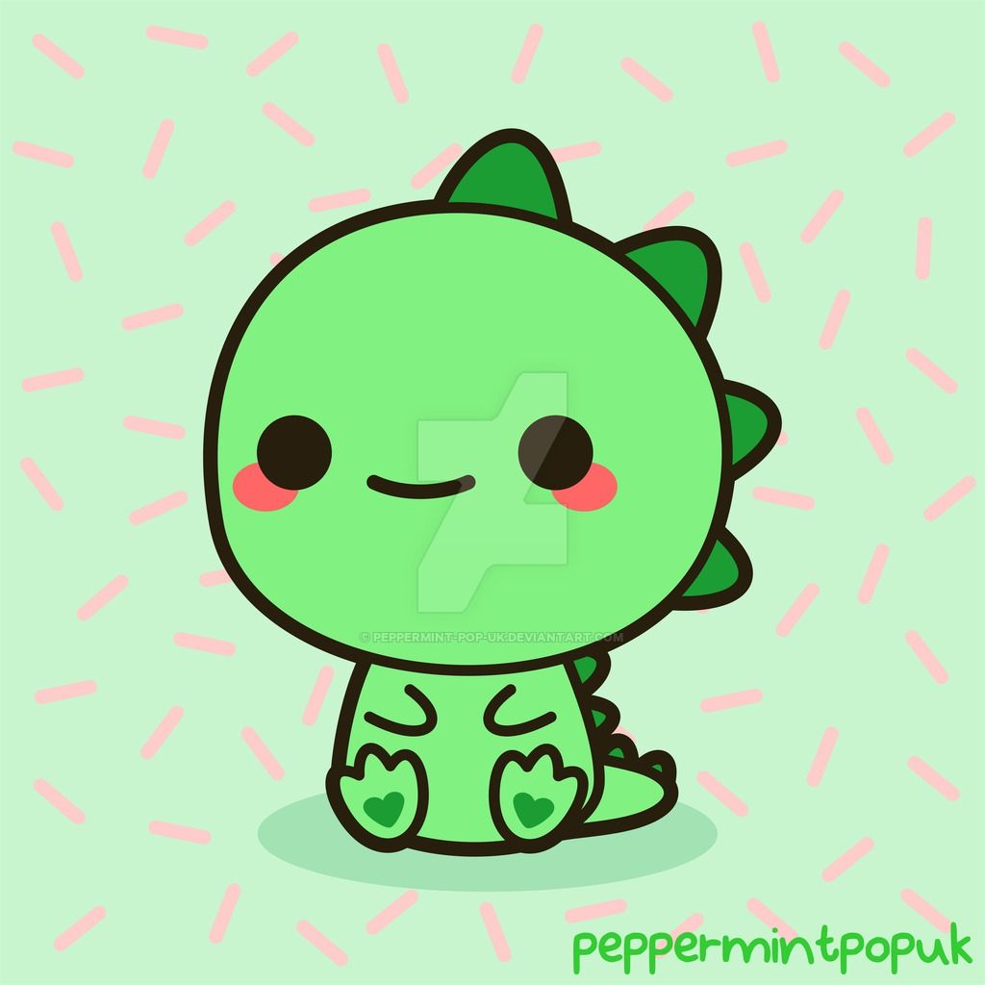
All things Kawaii
Kawaii creatures have limited facial features—two wide eyes, a small nose, and maybe a dot for the mouth
Kawaii characters may be pastel-colored, graphically simple, and childlike.
They may also have big heads and little bodies in order to match the proportions of infants or baby animals.

Slide 5
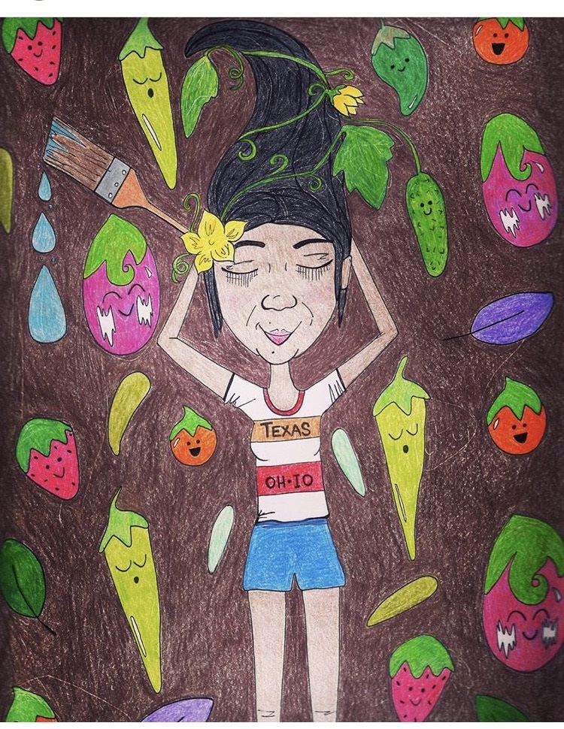
How I used kawaii in my drawings
“Summer
Of the garden”

Slide 6
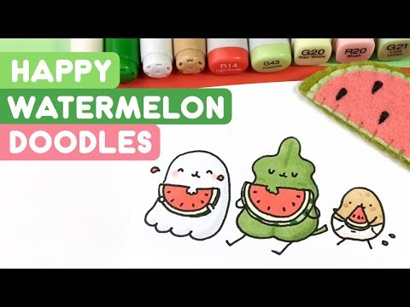
One of my favorite kawaii artist: Kira Kira Doodles
Kira Kira Doodles
Notes:
This is a YouTube Video – Click on Image to Play

Slide 7
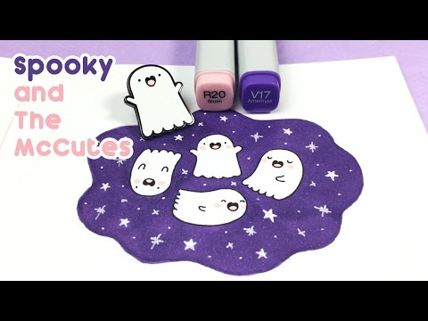
Notes:
This is a YouTube Video – Click on Image to Play

